Slide 1
Admin
Supplier User Guide

Slide 2
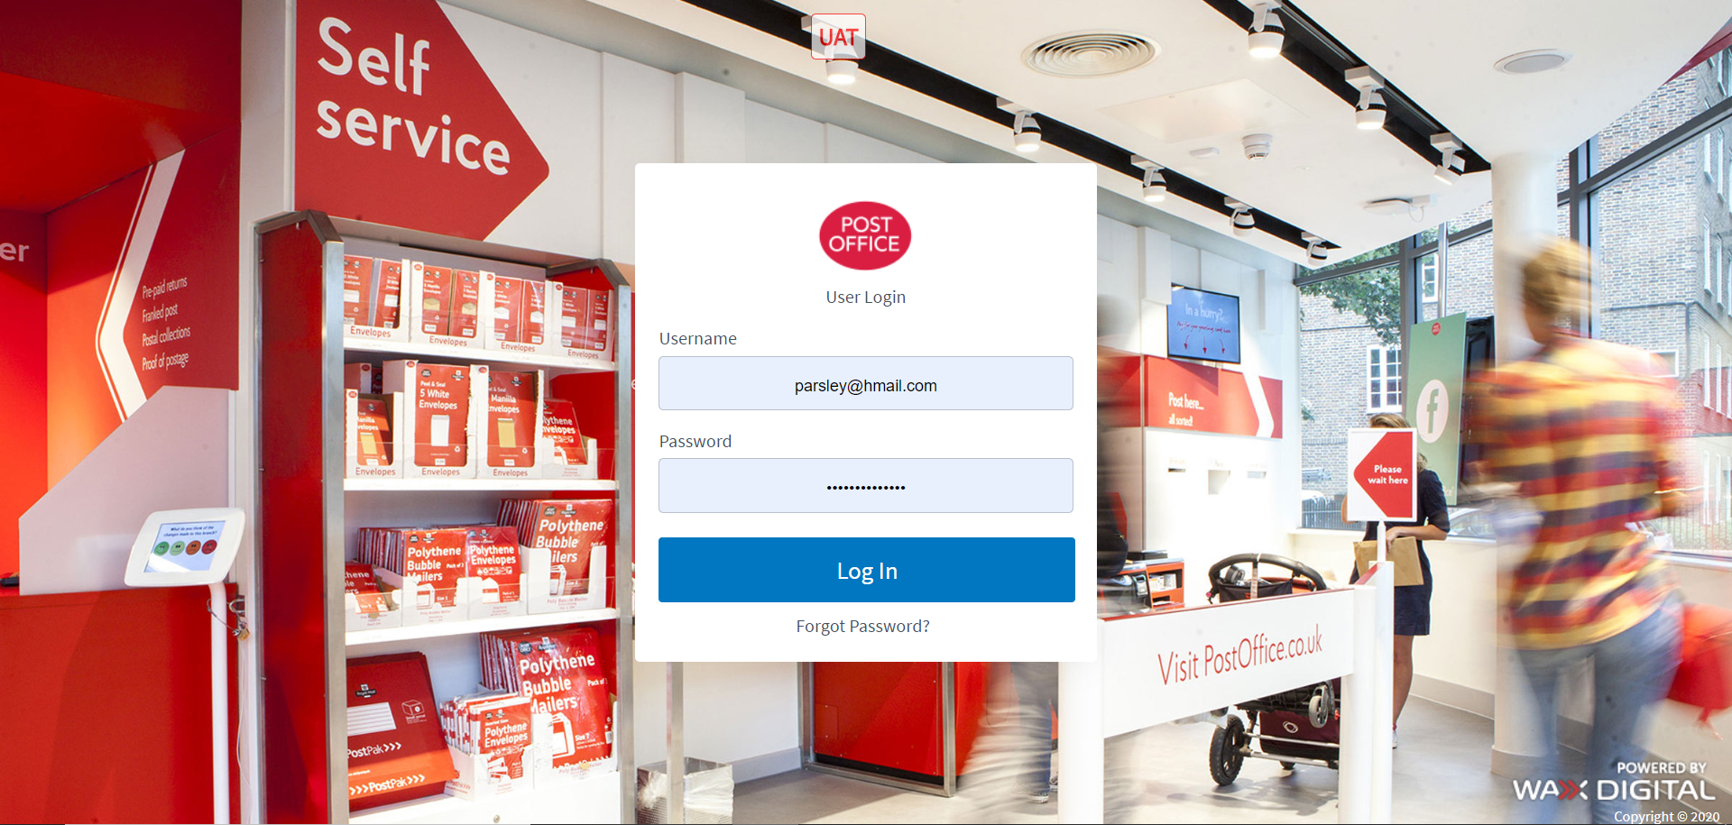

Logging in to web3
Admin Supplier User Guide
1
Use this option to register for web3, and set up your account.
2
To login, enter your username and password, then click ‘Login’.
3
If you have forgotten your password, click here.

Slide 3
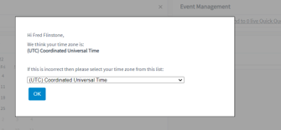
Once Registered
Admin Supplier User Guide
The first thing you will see is a request to set the time.
Once this has been set you will enter the system in the Sourcing Module.

Slide 4
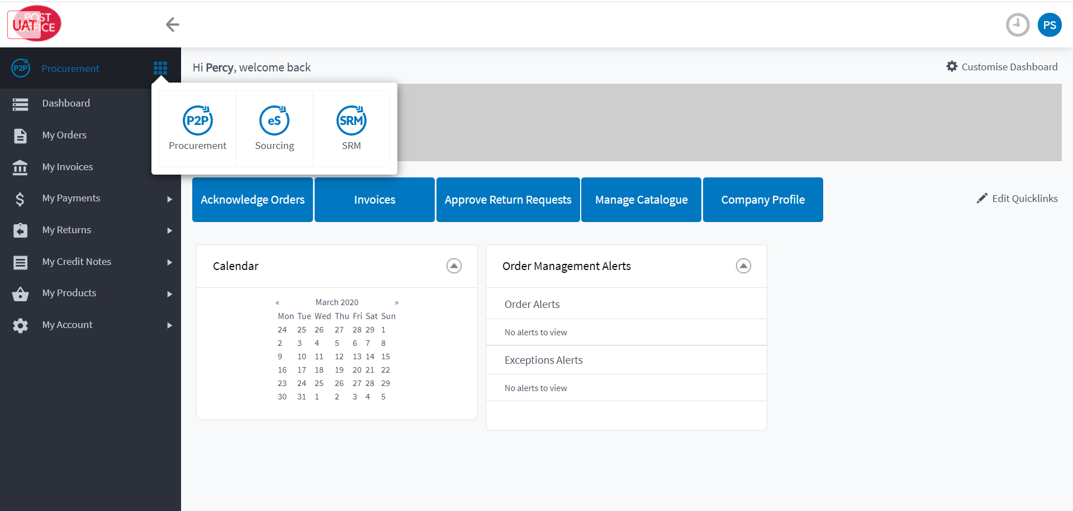
Changing between web3 modules
Admin Supplier User Guide
1
Web3 has different modules you can use for different purposes.
2
To navigate between modules, click the waffle button.
3
Then select the module needed. You may not have all of the modules here.

Slide 5
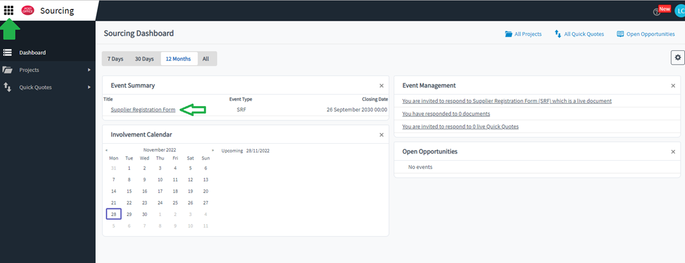

Sourcing and the SRF
Admin Supplier User Guide
1
In Sourcing you can see any tender events you have been invited to.
2
To navigate between modules, click the waffle button.
The Supplier Registration Form or SRF is here.

Slide 6
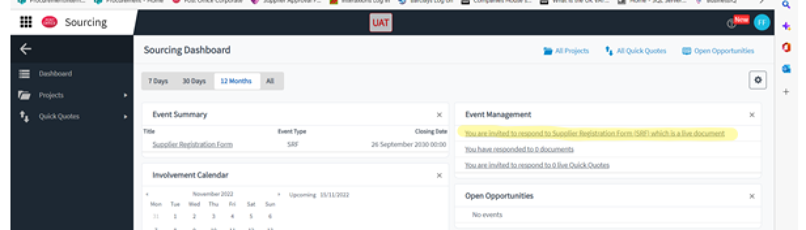
Supplier Registration Form
Admin Supplier User Guide
This is where you will find the SRF if you have been invited.

Slide 7
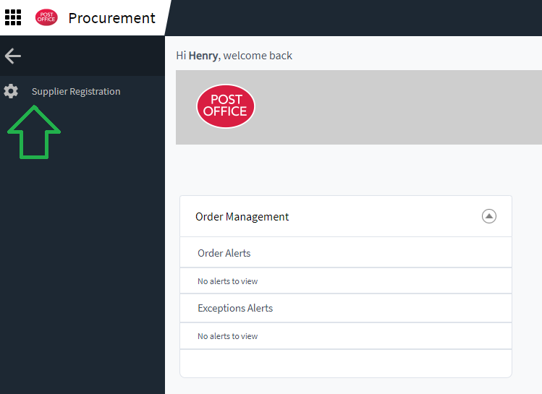
Procurement and Financial information
Admin Supplier User Guide
1
When you first go to Procurement it will ask you to create your account.
2
To navigate between modules, click the waffle button.

Slide 8
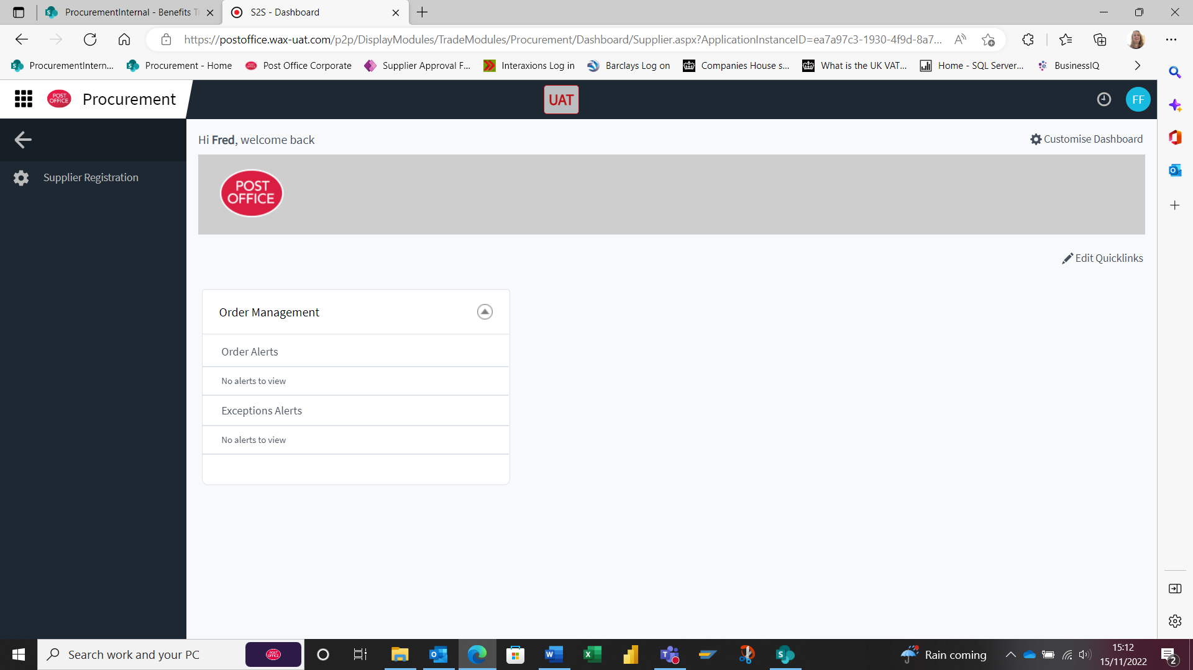
Registering company Financial details
Admin Supplier User Guide
Once in the Procurement Module for the first time you will find the Supplier Registration.
Click in here to find the Banking Details

Slide 9
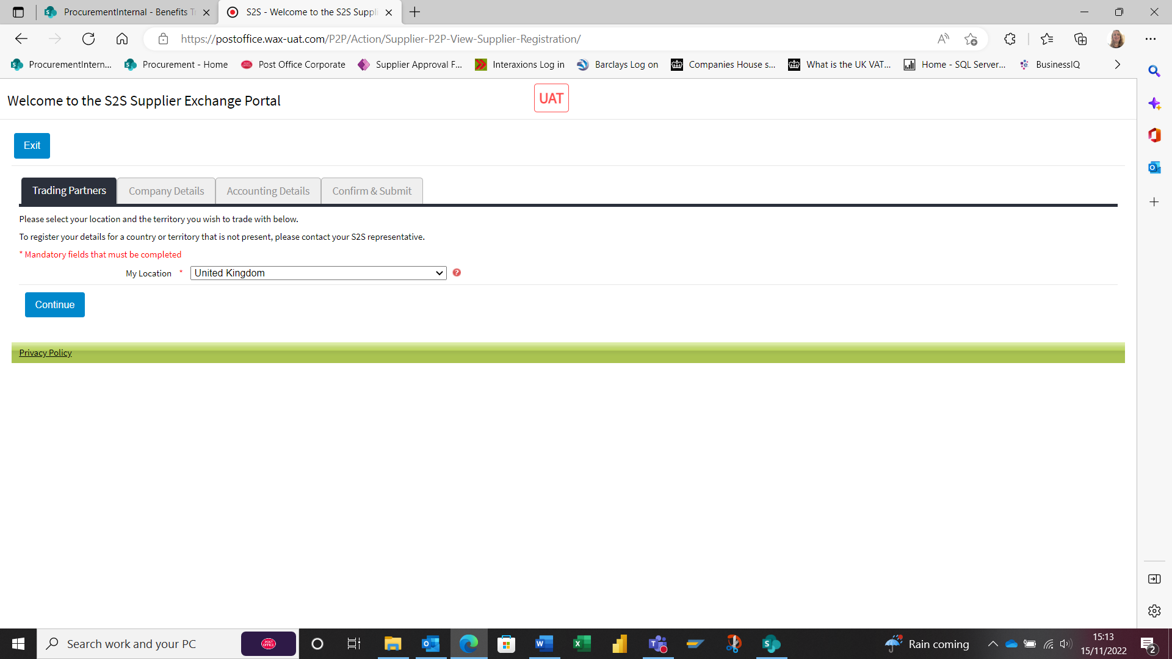
Registering company Financial details (Con’t)
Admin Supplier User Guide
Each section will need to be completed before it can be submitted.
In the Company Details you will need to click on True for Company Registration number and VAT Number with GB at the front (If Applicable).
In Accounting details once you select Bank Account for the Payment details, it will open the options to enter Bank details.

Slide 10
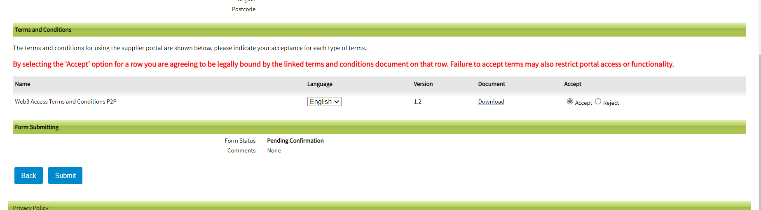
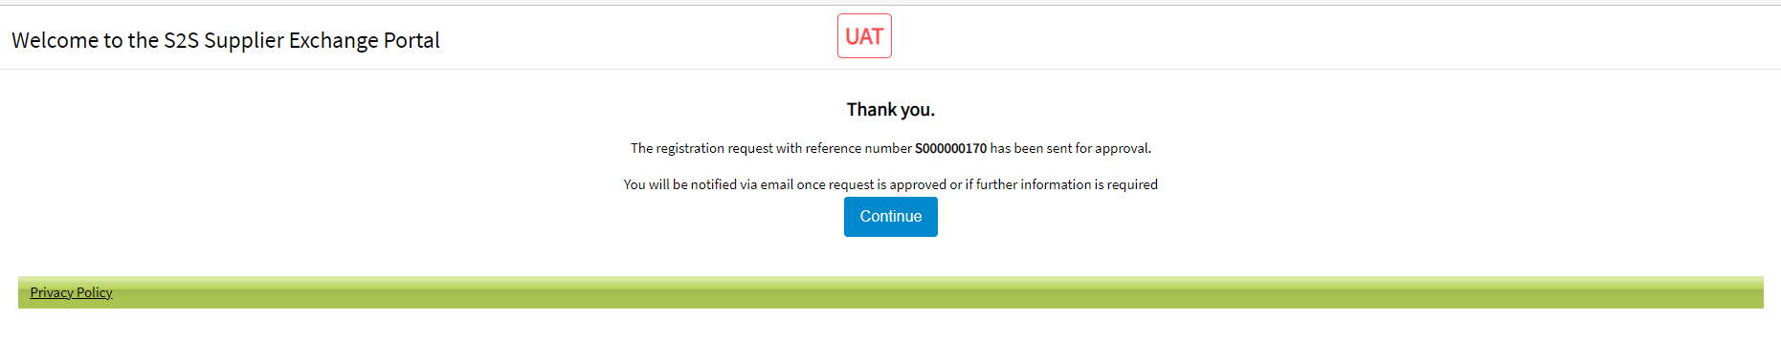
Editing company details
Admin Supplier User Guide
Once all section are completed then you can click on submit.
If this is rejected by Post Office, there will be a reason given and when you enter Web3 again there will be a button at the bottom called Modify and Re-submit which will allow the changes to be made before it is submitted again for Approval.

Slide 11
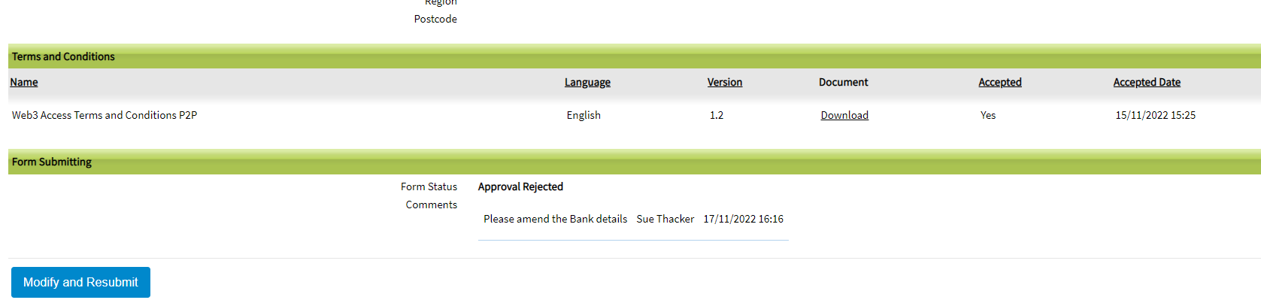
Editing company details (Con’t)
Admin Supplier User Guide
If this is rejected by Post Office, there will be a reason given and when you enter Web3 again there will be a button at the bottom called Modify and Re-submit which will allow the changes to be made before it is submitted again for Approval.

Slide 12
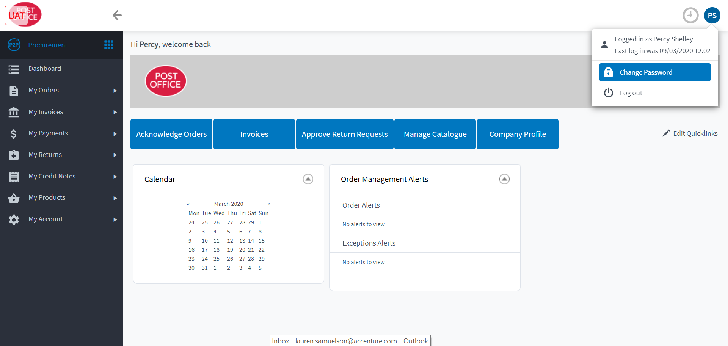
Administration of account after registration –
Changing your password
Admin Supplier User Guide
1
To change your password, click this button.
2
Then select this option.

Slide 13
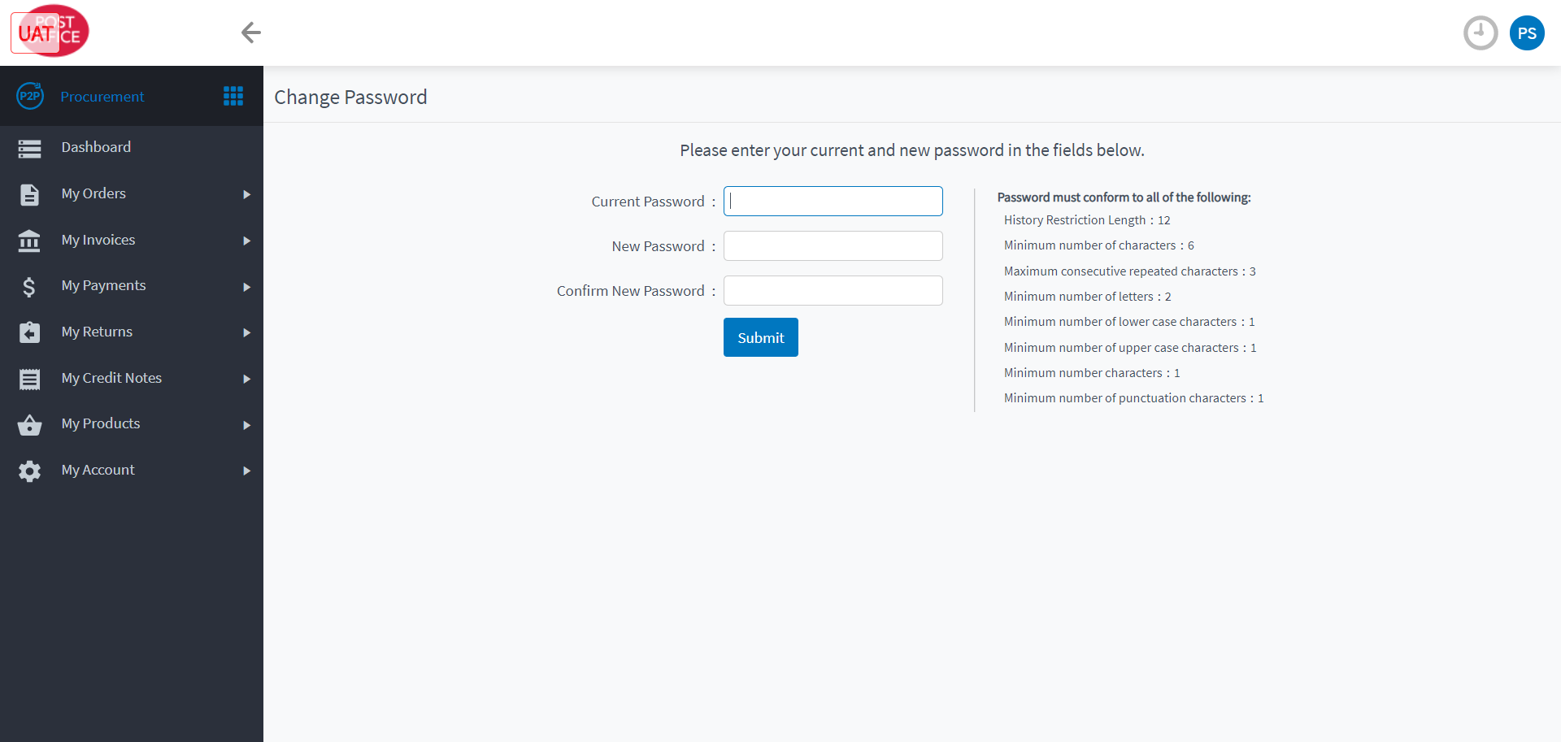
Changing your password cont.
Admin Supplier User Guide
1
Enter your old password, and choose a new one fitting the restrictions.
2
Click ‘Submit’.

Slide 14
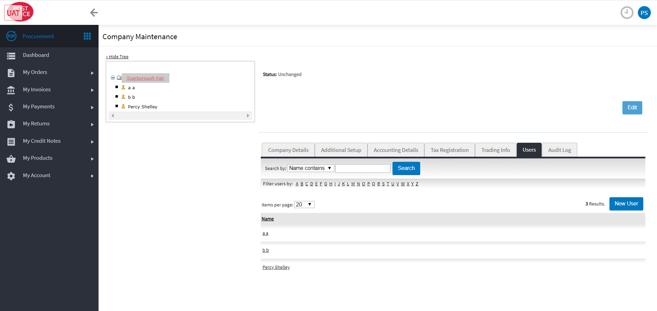
Adding a new user
Admin Supplier User Guide
1
Click on the ‘Users’ tab.
2
Click ‘New User’.

Slide 15
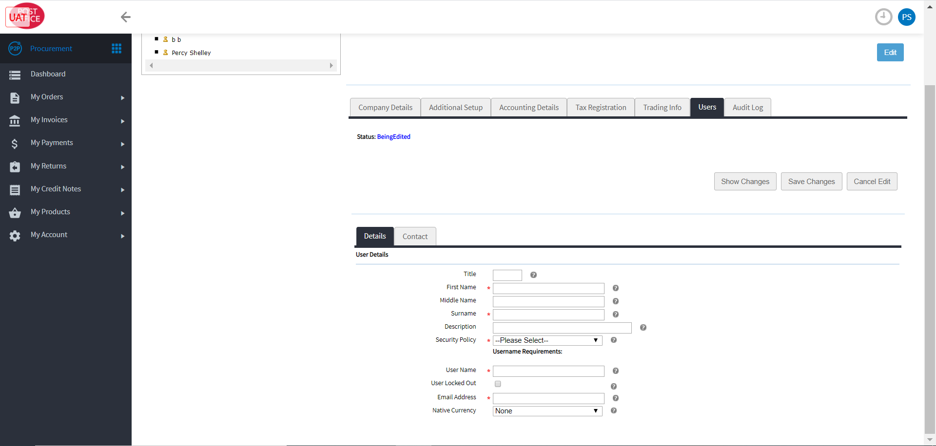
Adding a new user cont.
Admin Supplier User Guide
1
Add the user’s details.
2
Click ‘Save Changes’.

Slide 16
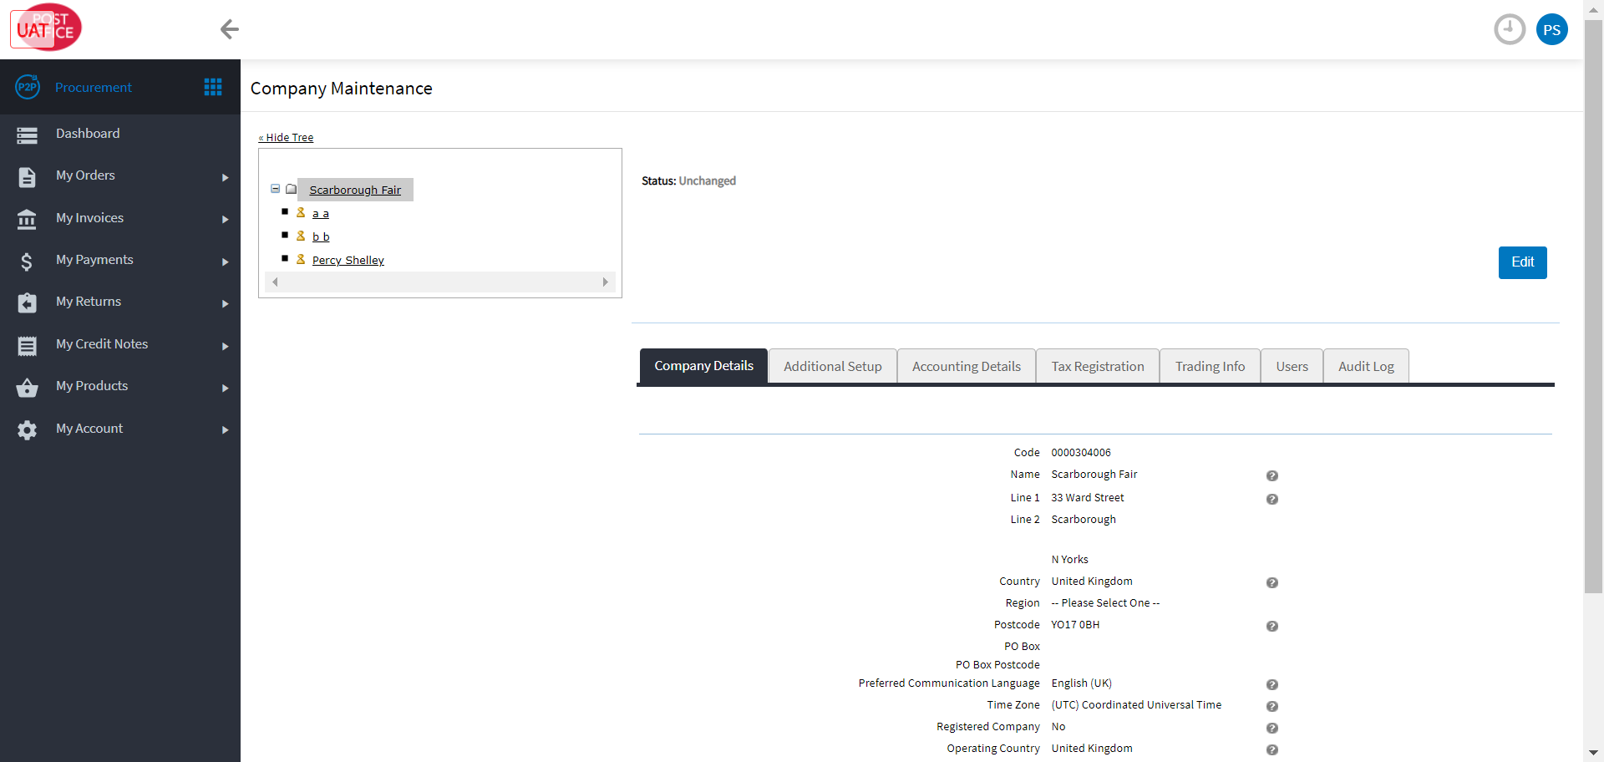
Editing user details
Admin Supplier User Guide
1
Click on the user to edit.

Slide 17
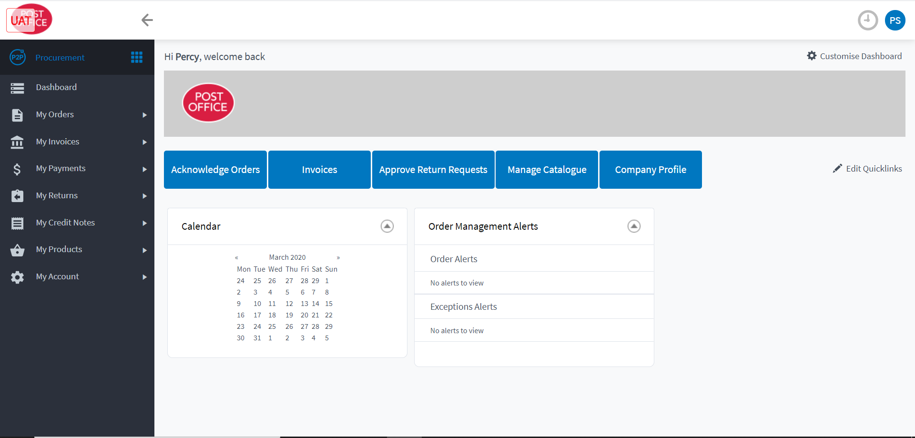
Customising your dashboard
Admin Supplier User Guide
1
You can edit your dashboard tiles and your Quicklinks.
2
To customise your dashboard tiles, click here.
3
To customise your Quicklinks, click here.

Slide 18
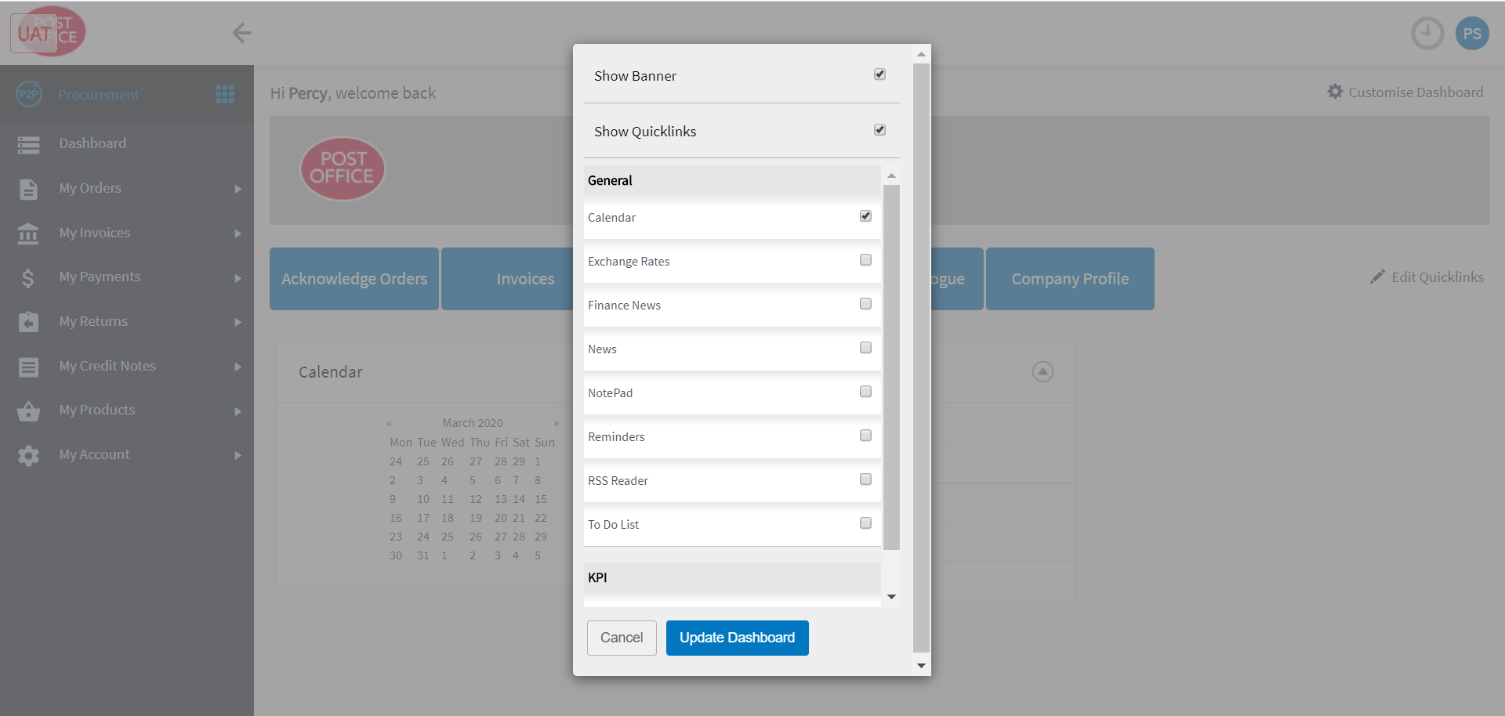
Customising dashboard tiles
Admin Supplier User Guide
1
Select the dashboard tiles you want.
2
Click ‘Update Dashboard’.

Slide 19
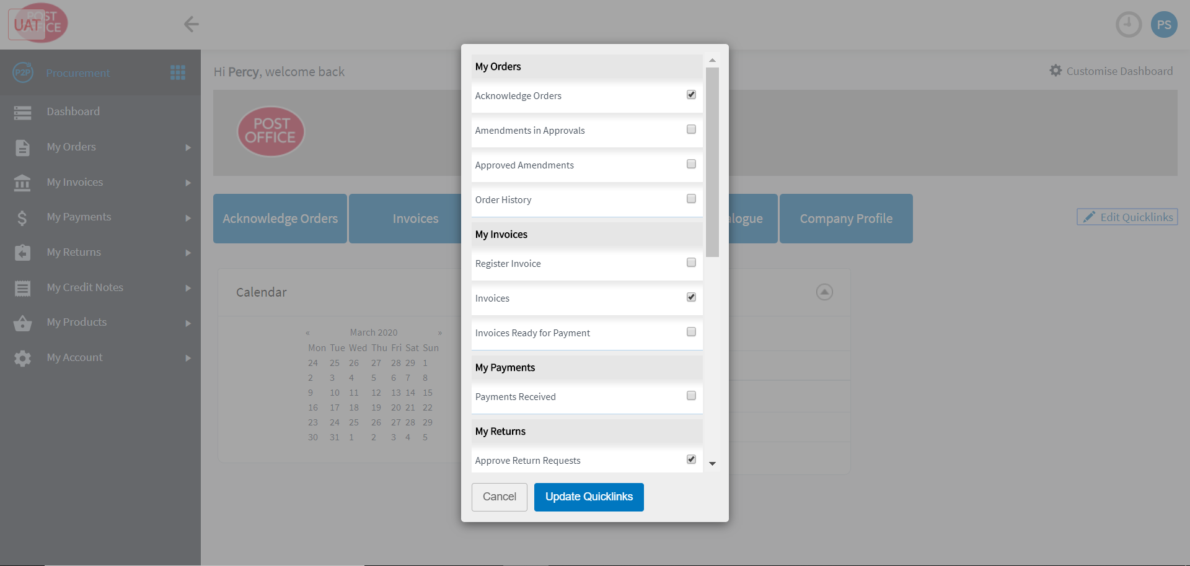
Customising Quicklinks
Admin Supplier User Guide
1
Select the Quicklinks you want.
2
Click ‘Update Quicklinks’.

